Slide 1
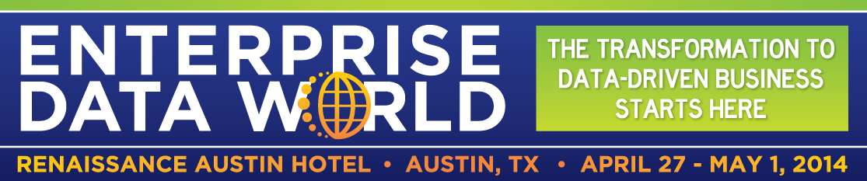
Introduction to NoSQL and New Database Technologies
An Introduction for Newcomers
Dan McCreary
Monday April 28th, 2014
1:30pm to 4:45pm

Slide 2
Session Goals
Targeted at anyone that is new to the NoSQL movement
No program code
...but experience with databases helps
Explain NoSQL "buzzwords" in context
NoSQL vs. "Big Data"
Understand four new "NoSQL" Patterns
Understand what types of problems they solve
Key products and players
Suggest an objective selection process
Copyright Kelly-McCreary & Associates, LLC

Slide 3
Before NoSQL
Relational
Analytical (OLAP)
Copyright Kelly-McCreary & Associates, LLC
3

Slide 4
After NoSQL
Relational
Analytical (OLAP)
Key-Value
key
value
key
value
key
value
key
value
Column-Family
Graph
Document
Copyright Kelly-McCreary & Associates, LLC
4

Slide 5
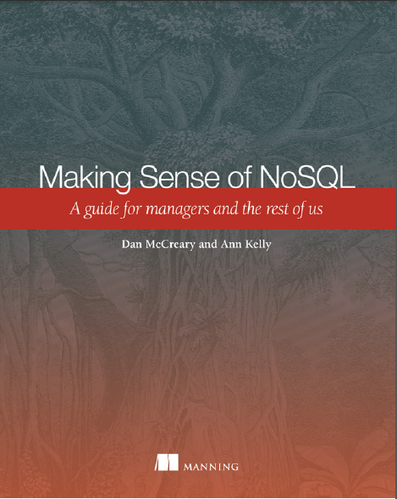


Making Sense of NoSQL
Authors of Manning book on NoSQL (MEAP now, in print Aug 2013)
Guide for managers and architects
Focus on NoSQL architectural tradeoff analysis
Basis for 40 hour course on database architectures
http://manning.com/mccreary

Slide 6


Role of the Solution Architect
Help!
Relational
Analytical (OLAP)
Key-Value
k
v
k
v
k
v
k
v
Column-Family
Graph
Document
Business Unit
Sally Solutions
Solution Architect
Non-bias matching of business problem to the right data architecture before we begin looking at a specific products

Slide 7
Background for Dan McCreary
Chip Designer at Bell Labs
Software Engineer for High Performance Computing
NeXT Computer (Steve Jobs)
Owner of 75-person software consulting firm
US Federal data integration (National Information Exchange Model NIEM.gov)
Native XML/XQuery for metadata management since 2006
Advocate of web standards, NoSQL and XRX systems
Copyright Kelly-McCreary & Associates, LLC

Slide 8
Sample of NoSQL Jargon
Document orientation
Schema free
MapReduce
Horizontal scaling
Sharding and auto-sharding
Brewer's CAP Theorem
Consistency
Reliability
Partition tolerance
Single-point-of-failure
Object-Relational mapping
Key-value stores
Column stores
Document-stores
Memcached
Indexing
B-Tree
Configurable durability
Documents for archives
Functional programming
Document Transformation
Document Indexing and Search
Alternate Query Languages
Aggregates
OLAP
XQuery
MDX
RDF
SPARQL
Architecture Tradeoff Modeling
ATAM
Erlang
Note that within the context of NoSQL many of these terms have different meanings!
Copyright Kelly-McCreary & Associates, LLC

Slide 9
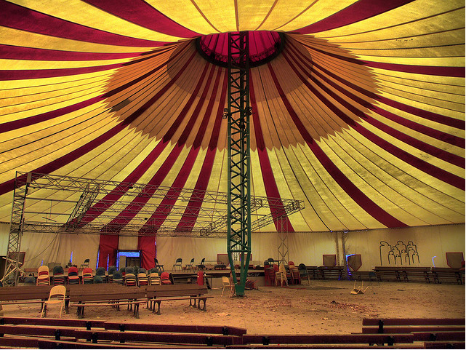
NoSQL – The Big Tent
"NoSQL" – a label for a "meme" that now encompasses a large body of innovative ideas on data management
"Not Only SQL"
Focus on non-relational databases and hybrids
A community were new ideas are quickly recombined to create innovative new business solutions
http://www.flickr.com/photos/morgennebel/2933723145/
Copyright Kelly-McCreary & Associates, LLC

Slide 10
Conference Themes
Selecting the right data management solution is no longer a trivial task
Does it look like document?
Use Microsoft
Office
Yes
Start
No
Use the RDBMS
Stop

Slide 11
Pressures on Single Node RDBMS Architectures
Scalability
Large Data Sets
Reliability
Single Node
RDBMS
OLAP/BI/Data Warehouse
Social Networks
Document-Data
Linked Data
Agile
Schema Free

Slide 12
An evolving tree of data types
Web Crawlers
Open Linked Data
RDBMS
BI/DW
Log Files
JSON
Transactional
Read Mostly
Read/Write
XML
Binary
Graph
Documents
Structured
Unstructured

Slide 13
Many Uses of Data
Transactions (OLTP)
Analysis (OLAP)
Search and Findability
Enterprise Agility
Discovery and Insight
Speed and Reliability
Consistency and Availability

Slide 14
Three Eras of Enterprise Data
Siloed Systems
ERP Drives BI/DW
NoSQL and Documents
ERP
ERP
Documents
Documents
OLTP
HR
Finance
Inventory
Sales
BI/Data Warehouse
BI/Data Warehouse
NoSQL
OLAP
1970s, 80s, 90s
1990s, 2000s
Today
NoSQL will not replace ERP or BI/DW systems – but they will complement them and also facilitate the integration of unstructured document data
Copyright Kelly-McCreary & Associates, LLC

Slide 15

Simplicity is a Virtue
Many modern systems derive their strength by dramatically limiting the features in their system and focus on a specific task
Simplicity allows database designer to focus on the primary business drivers
Simplicity promotes "separation of concerns"
Photo from flickr by PSNZ Images
Copyright Kelly-McCreary & Associates, LLC

Slide 16

Simplicity is a Design Style
Focus only on simple systems that solve many problems in a flexible way
Examples:
Touch screen interfaces
Key/Value data stores
Copyright Kelly-McCreary & Associates, LLC

Slide 17
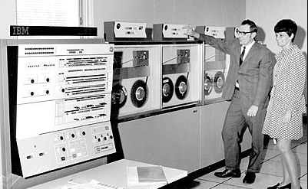
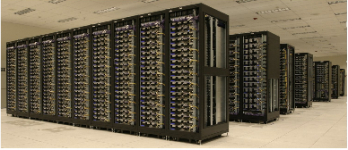
Historical Context
Mainframe Era
Commodity Processors
1 CPU
COBOL and FORTRAN
Punchcards and flat files
$10,000 per CPU hour
10,000 CPUs
Functional programming
MapReduce "farms"
Pennies per CPU hour

Slide 18
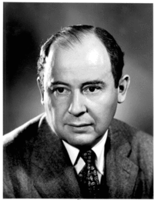
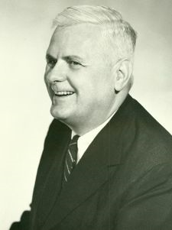
Two Approaches to Computation
1930s and 40s
John von Neumann
Alonzo Church
Manage state with a program counter.
Make computations act like math functions.
Which is simpler? Which is cheaper? Which will scale to 10,000 CPUs?

Slide 19
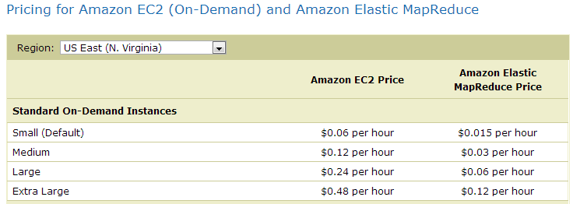
Standard vs. MapReduce Prices
John's Way
Alonzo's Way
http://aws.amazon.com/elasticmapreduce/#pricing
Copyright Kelly-McCreary & Associates, LLC

Slide 20
MapReduce CPUs Cost Less!
75% Cost
Reduction!
Cust cost from 12 to 3 cents per CPU hour!
Perhaps Alonzo was right!
EC2
MapReduce
Why? (hint: how "shareable" is this process)
http://aws.amazon.com/elasticmapreduce/#pricing
Copyright Kelly-McCreary & Associates, LLC

Slide 21
Perspectives
Object
Stores
OLAP
MDX
Native XML
NoSQL for
Web 2.0
and
BigData
Graph
Stores
Perspective depends on your context
Copyright Kelly-McCreary & Associates, LLC

Slide 22

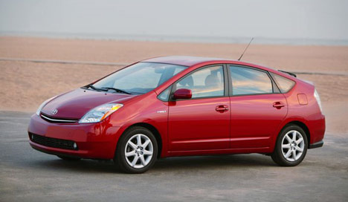
Architectural Tradeoffs
I want a fast car with good mileage.
I want a scaleable database with low cost that runs well on the 1000 CPUs in our data center.

Slide 23
Recent History
The term NoSQL became re-popularized around 2009
Used for conferences of advocates of non-relational databases
Became a contagious idea "meme"
First of many "NoSQL meetups" in San Francisco organized by Jon Oskarsson
Conversion from "No SQL" to "Not Only SQL" in recent year
Copyright Kelly-McCreary & Associates, LLC

Slide 24
Key Events on NoSQL Timeline
Open Source
Becomes Popular
LiveJournal's Memcache
XQuery 1.0
Recommendation
MDX
Eric Evans
Reintroduces Term
Carlo Strozzi
Intros NoSQL
Google
MapReduce
Google
Bigtable
Amazon
Dynamo
NoSQL Meetups
1998
2003
2004
2005
2006
2007
2008
2009
2010

Slide 25
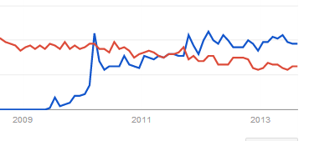
NoSQL on Google Trends
RDBMS
NoSQL
http://www.google.com/trends/explore?q=NoSQL%2C+RDBMS#q=NoSQL%2C%20RDBMS&cmpt=q
Kelly-McCreary & Associates, LLC

Slide 26
NoSQL and Web 2.0 Startups
Many web 2.0 startups did not use Oracle or MySQL
They built their own data stores influenced by Amazon’s Dynamo and Google’s Bigtable in order to store and process huge amounts of data
In the social community or cloud computing applications most of these data stores became open source software
Kelly-McCreary & Associates, LLC

Slide 27

2003 - Memcachedb
Originally developed for LiveJournal as a "side-cache"
Allowed databases to put data in a "RAM Cache" in front of a SQL server to speed up read-mostly operations
Dramatically lowers load on backend SQL server
Ideal "front end" to database system to increase performance

Slide 28
Partition Select and Updates
memcachedb
memcachedb
Select
memcachedb
Sync with memcached protocol
Insert
Update
Delete
SQL "System of
Record"
Most frequently read data always stays in RAM
Complex update transactions go directly to the database
Example of separation of concerns

Slide 29
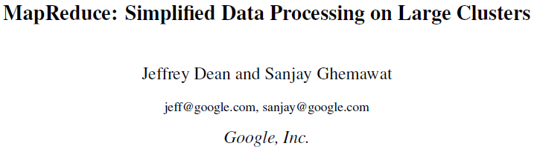
Google MapReduce
2004 paper that had huge impact of functional programming on the entire community
Copied by many organizations, including Yahoo

Slide 30
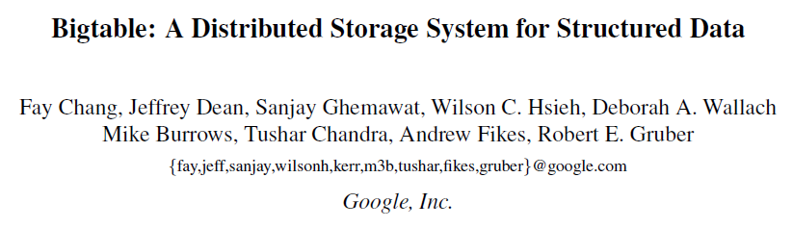
Google Bigtable Paper
2006 paper that gave focus to scaleable databases
designed to reliably scale to petabytes of
data and thousands of machines

Slide 31
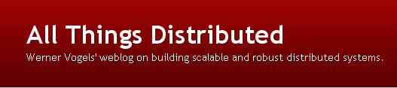

Amazon's Dynamo Paper
Werner Vogels
CTO - Amazon.com
October 2, 2007
Used to power Amazon's Web Sites
One of the most influential papers in the NoSQL movement
Giuseppe DeCandia, Deniz Hastorun, Madan Jampani, Gunavardhan Kakulapati, Avinash Lakshman, Alex Pilchin, Swami Sivasubramanian, Peter Vosshall and Werner Vogels, “Dynamo: Amazon's Highly Available Key-Value Store”, in the Proceedings of the 21st ACM Symposium on Operating Systems Principles, Stevenson, WA, October 2007.

Slide 32
NoSQL "Meetups"
“NoSQLers came to share how they had overthrown the tyranny of slow, expensive relational databases in favor of more efficient and cheaper ways of managing data.”
Jul 1, 2009
Computerworld magazine
http://www.computerworld.com/s/article/9135086/No_to_SQL_Anti_database_movement_gains_steam_

Slide 33
Key Business Motivators
Licensing RDBMS on multiple CPUs
The Thee "V"s of NoSQL + Agility
Velocity
Volume
Variability
Agility
Desire to escape rigid schema design
Avoidance of complex Object-Relational Mapping (the "Vietnam" of computer science)

Slide 34
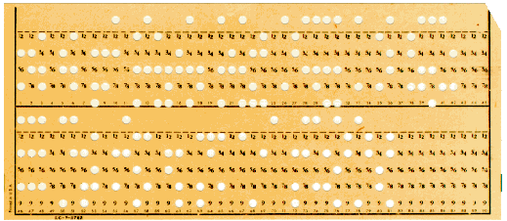
Many Processes Today Are Driven By…
The constraints of yesterday…
Challenge:
Ask ourselves the question…
Do our current method of solving problems with tabular data…
Reflect the storage of the 1950s…
Or our actual business requirements?
What structures best solve the actual business problem?

Slide 35
No-Shredding!
My Form
Data
Relational databases take a single hierarchical document and shred it into many pieces so it will fit in tabular structures
Document stores prevent this shredding

Slide 36
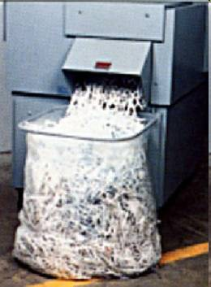
Is Shredding Really Necessary?
Every time you take hierarchical data and put it into a traditional database you have to put repeating groups in separate tables and use SQL “joins” to reassemble the data

Slide 37
"Schema Free"
Systems that automatically determine how to index data as the data is loaded into the database
No a priori knowledge of data structure
No need for up-front logical data modeling
…but some modeling is still critical
Adding new data elements or changing data elements is not disruptive
Searching millions of records still has sub-second response time

Slide 38
Schema-Free Integration
XML
v1
XML
v2
XML
v3
NoSQL
Database
Enterprise Messaging System
"We can easily store the data that we actually get, not the data we thought we would get."

Slide 39
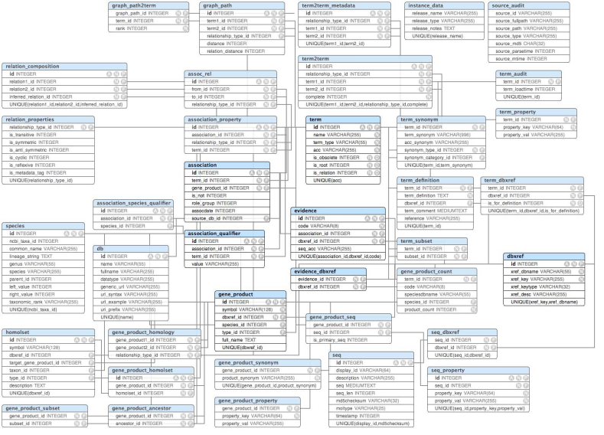
Upfront ER Modeling is Not Required
You do not have to finish modeling your data before you insert your first record
No Data Definition Language "DDL" is needed
Metadata is used to create indexes as data arrives
Modeling becomes a statistical process – write queries to find exceptions and normalize data
Exceptions make the rules but can still be used
Data validation can still be done on documents using tools such as XML Schema and business rules systems like Schematron

Slide 40
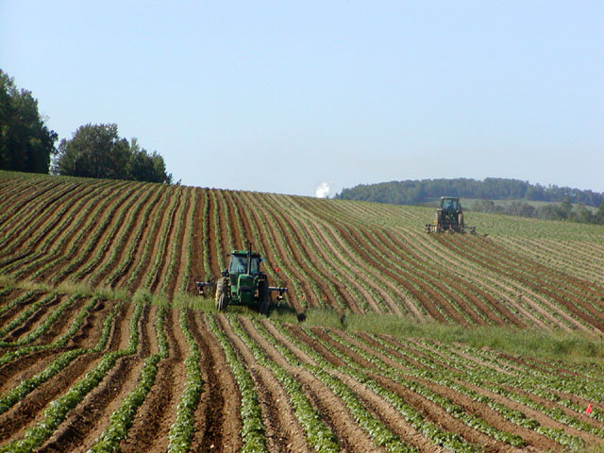
Monoculture and Mono-architecture
Image Source: Wikipedia

Slide 41

Eric Evans
“The whole point of seeking alternatives [to RDBMS systems] is that you need to solve a problem that relational databases are a bad fit for.”
Eric Evans
Rackspace

Slide 42
Finding the Right Match
Schema-Free
Standards Compliant
Mature Query Language
Use CMU's Architectural Tradeoff and Modeling (ATAM) Process

Slide 43
Horizontal Scalability and Running on Commodity Hardware
“Definitely, the volume of data is getting so huge that people are looking at other technologies”
Jon Travis - SpringSource

Slide 44



Scale Up vs. Scale Out
Scale Up
Scale Out
Make a single CPU as fast as possible
Increase clock speed
Add RAM
Make disk I/O go faster
Make Many CPUs work together
Learn how to divide your problems into independent threads

Slide 45
The "Hash Mod"
Customer ID
Hash
MD5
Hash "ring"
Create a hash of the "key"
Use the initial bits or the "modulo" of the hashed value
Use this to distribute the item to the cluster
Allows even distribution of data over a cluster

Slide 46
Automatic Sharding
Warning processor at 90% capacity!
Time to "Shard" – copy ½ data to a new processor
Before
Shard
After
Shard
Each processor gets ½ the load
Original processor
New processor
When one node in a cluster has too much of a load

Slide 47

ACID Transactions
Atomic – transaction either complete or fail – no in-between
Consistent – no reports can ever catch data between states
Isolated – never allow users to touch data that is incomplete
Durable – recover committed transactions from partial system failures

Slide 48
ACID Definition of Consistency
Steps
From Account:
Savings
Start
Begin transaction
To Account:
Checking
1
Withdraw 1,000 from Savings
Amount:
1,000.00
2
Deposit 1,000 into Checking
Transfer
End
End transaction
Reports will never show a total balance after withdrawal and before deposit

Slide 49

BASE
Base Availability of Soft state Eventually Consistent
"Eventually Consistent" is not appropriate for many financial reporting systems

Slide 50
Consistency
In RDBMS Systems
reports will always get a consistent value
never results from first part of a transaction
In Distributed Computing
rules that determine if a read from a cluster has verified that multiple nodes all have the same value

Slide 51

Partition Tolerance
Rack1
Rack 2
Node
Node
Node
Node
Node
Node
What happens when you get a "split brain" in your data center?
One part of your cluster can not talk to the other part of the cluster?
High availability systems want to write to multiple nodes in a cluster if one node fails

Slide 52
Brewer's CAP Theorem
Consistency
You cannot have all three so pick two!
Availability
Partition Tolerance

Slide 53
Proof of Brewer's CAP Theorem
In 2002, Seth Gilbert and Nancy Lynch of MIT, formally proved Brewer's Theorem to be correct
Focus turned away from trying to get all three to trying to pick the right two for the job
Many systems are becoming "CAP tunable"

Slide 54
CAP Systems
CA – Consistent and Available
Example – a single site, single database, no auto-sharding
If you have to partition, stop, partition, restart
CP – Consistent with Partition Tolerance
Some data not available when partitioning
What data you have is always consistent
AP – Available with Partition Tolerance
Always on, but during partitioning, some data may be inconsistent
After sharding eventual consistency

Slide 55
NoSQL "Clusters"
Rack1
Rack 2
Read
Node
Node
Cross Data Center
Remote Data Center
Write
Node
Node
Node
Node
How many nodes should we check to guarantee a consistent read?
How many nodes should we write to in order to make sure our write is "durable"

Slide 56
CAP Regions
Consistency
CA
CP
RDBMS
NoSQL Innovation
Availability
AP
Partition Tolerance

Slide 57
Availability Consistency Option
Normal Operation
High Availability Option
High Consistency Option
Client
write
Master
Client
write
Master
write
Client
Master
OK
block
copy
Client
read
Slave
Slave
Slave
The CAP theorem gives designers choices on how to behave when a remote system is down – during a "Network Partition"
Application designers can select different options for each transaction

Slide 58
Complexity and Cost of Setting up Database Clusters
NoSQL databases are designed in a way that PC clusters can be easily and cheaply expanded without the complexity and cost of ’sharding,’ which involves cutting up databases into multiple tables to run on large clusters or grids
Nati Shalom, CTO and founder of GigaSpaces

Slide 59
The Tunable SLA
inputs
output
Max Read
Time
Max Write
Time
Reads Per
Second
Writes Per
Second
Duplicate
Copies
Multiple
Datacenters
Transaction
Guarantees
Estimated
Price/Month
$435.50
NoSQL systems that use many commodity processors can be precisely tuned to meet an organizations service level agreements

Slide 60
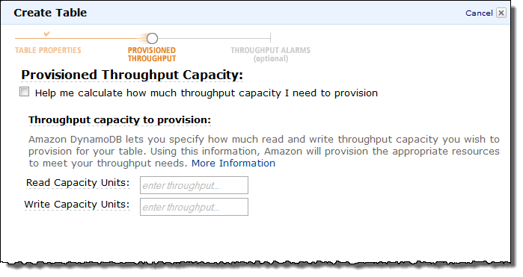
Example: Amazon DynamoDB
Tuning Knobs
Tune your service to the business requirements (challenging to do with a RDBMS)

Slide 61


"One Size Fits…"
"One Size Does Not Fit All"
James Hamilton Nov. 3rd, 2009
http://perspectives.mvdirona.com/CommentView,guid,afe46691-a293-4f9a-8900-5688a597726a.aspx

Slide 62
The Eight Fallacies of Distributed Computing
Essentially everyone, when they first build a distributed application, makes the following eight assumptions. All prove to be false in the long run and all cause big trouble and painful learning experiences.
1. The network is reliable
2. Latency is zero
3. Bandwidth is infinite
4. The network is secure
5. Topology doesn't change
6. There is one administrator
7. Transport cost is zero
8. The network is homogeneous
Peter Deutsch

Slide 63

NoSQL and Cloud Computing
High scalability
Especially in the horizontal direction (multi CPUs)
Low administration overhead
Simple web page administration
Lower fees for MapReduce transformations

Slide 64
Most databases work well in the cloud
Data warehousing-specific databases for batch data processing and map/reduce operations
Focus on batch processing of pre-calculated sums/totals (aggregates)
Simple, scalable and fast key/value-stores can be deployed as services
Databases containing a richer feature set than key/value-stores fitting the gap with traditional RDBMSs while offering good performance and scalability properties (such as document databases)

Slide 65
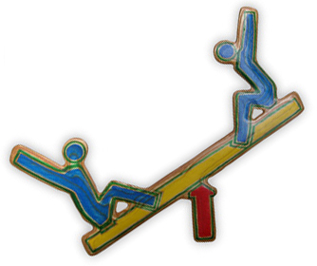
NoSQL Tradeoffs
Many NoSQL systems are based around the concepts of leveraging many low-cost computers tied together with fast networks
But most distributed computing systems have an order-of-magnitude of greater management challenges when it comes to system failures and reliability
Continuous component failure must be assumed and managed

Slide 66
Evolution of Ideas in OpenSource
New Database Ideas
New Products
Proprietary Software
Product A
OpenSource
Schema-free
Product B
Auto-sharding
MapReduce
Product B
Cloud Computing
How quickly can new ideas be recombined into new database products?
OpenSource software has proved to be the most efficient way to quickly recombine new ideas into new products
The Nature of Technology: What It Is and How It Evolves by W. Brian Arthur

Slide 67












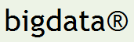







The NO-SQL Universe
Key-Value Stores
Document Stores
Graph/Triple Stores
XML
Column-Family Stores
Object Stores

Slide 68
NoSQL Database Patterns
Relational
Analytical (OLAP)
Key-Value
key
value
key
value
key
value
key
value
Column-Family
Graph
Document
68

Slide 69
Relational
Data is usually stored in row by row manner (row store)
Standardized query language (SQL)
Data model defined before you add data
Joins merge data from multiple tables
Results are tables
Pros: mature ACID transactions with fine-grained security controls
Cons: Requires up front data modeling, does not scale well
Examples:
Oracle, MySQL,
PostgreSQL,
Microsoft SQL Server, IBM DB/2

Slide 70
Analytical (OLAP)
Based on "Star" schema with central fact table for each event
Optimized for analysis of read-analysis of historical data
Use of MDX language to count query "measures" for "categories" of data
Pros: fast queries for large data
Cons: not optimized for transactions and updates
Examples:
Cognos, Hyperion, Microstrategy, Pentaho, Microsoft, Oracle, Business Objects

Slide 71
Key-Value Stores
Keys used to access opaque blobs of data
Values can contain any type of data (images, video)
Pros: scalable, simple API (put, get, delete)
Cons: no way to query based on the content of the value
key
value
key
value
key
value
key
value
Examples:
Berkley DB, Memcache, DynamoDB, S3, Redis, Riak

Slide 72
Key Value Stores
A table with two columns and a simple interface
Add a key-value
For this key, give me the value
Delete a key
Blazingly fast and easy to scale (no joins)
Key
Value
Blob datatype
string datatype

Slide 73
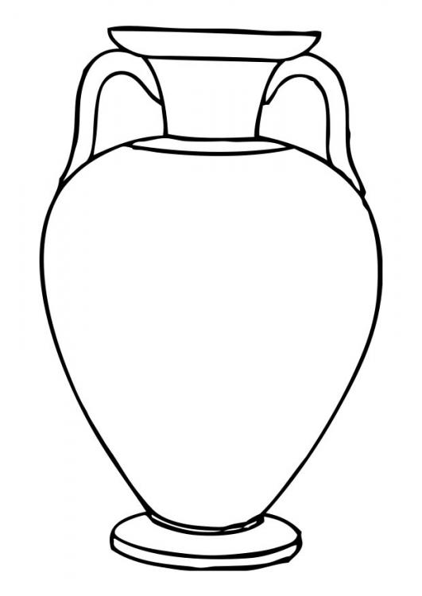
Key-Values Stores are Like Dictionaries
Key: "amphora"
Value: Text of dictionary entry
am·pho·ra
noun
1. A large two handled jar with a narrow neck used in ancient times by Greek and Romans to store or carry wine or oils.
2. A vessel, usually made of clay, with two handles or ears for liquids.
3. A measure for liquids; quadrantal; the measure of a ship.
plural: amphorae or amphoras
Similar words: flagon, pitcher, flask, bottle, jar.
Etymology
From ancient Greek, a vase shaped ornament with a narrow neck

Slide 74
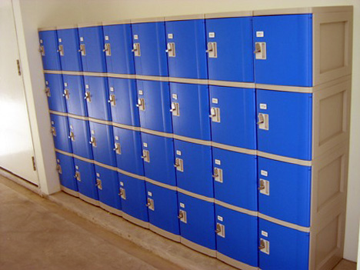
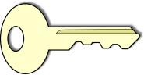
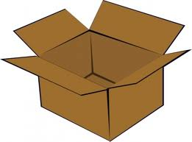
The Locker Metaphor
Key:
Value:
An arbitrary container data

Slide 75
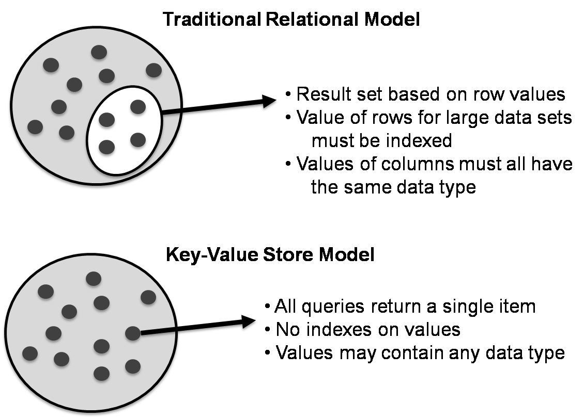
No Subset Queries in Key-Value Stores

Slide 76
Types of Key-Value Stores
Eventually‐consistent Key‐Value store
Hierarchical Key-Value Stores
Key-Value Stores In RAM
Key-Value Stores on Disk
Ordered Key-Value Stores

Slide 77

Memcached
Free & open source in-memory caching system
Make effective use of RAM on many distributed web servers
Designed to speed up dynamic web applications by alleviating database load
RAM resident key-value store for small chunks of arbitrary data (strings, objects) from results of database calls, API calls, or page rendering
Simple interface for highly distributed RAM caches
Designed for quick deployment, ease of development
APIs in many languages

Slide 78

Foundation DB
Ordered key-value storage
Focus on scalability and consistency
Support for ACID transactions
Replication and partitioning
Use of solid state drives
Vision: be the foundation layer for other database types

Slide 79

Oracle
Oracle NoSQL database is a key-value
Use hashed value of the primary key to select node
Storage nodes are replicated to ensure high availability
Rapid failover in the event of a node failure and optimal load balancing of queries
Applications are written using either a Java or C API
http://www.oracle.com/technetwork/products/nosqldb/overview/index.html

Slide 80
Riak
Open source distributed key-value store with support and commercial versions by Basho
A "Dynamo-inspired" database
Focus on availability, fault-tolerance, operational simplicity and scalability
Support for replication and auto-sharding and rebalancing on failures
Support for MapReduce, fulltext search and secondary indexes of value tags
Written in ERLANG

Slide 81

Aerospike
Commercial distributed key-value store
Focus on low-latency transactions
Optimized for solid-state drives
High availability – no single point of failure
Support for cross data center replication
APIs in C, C#, Java, Ruby, PHP and Python

Slide 82
Column-Family
Key includes a row, column family and column name
Store versioned blobs in one large table
Queries can be done on rows, column families and column names
Pros: Good scale out, versioning
Cons: Cannot query blob content, row and column designs are critical
Examples:
Cassandra, HBase, Hypertable, Apache Accumulo, Bigtable

Slide 83
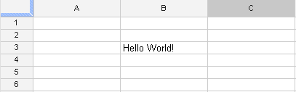
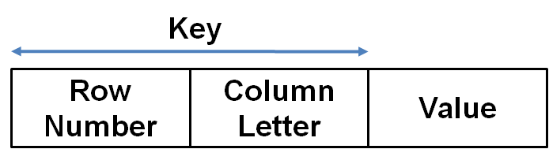
Spreadsheets Use a Row/Column as a Key
Column ID
Row ID
Bigtable systems use a combination of row and column information as part of their key

Slide 84
Column Families
Group columns into "Column families"
Group column families into "Super-Columns"
Can query all columns with a family or super family
Similar data grouped together to improve speed
Table
SuperCol X
SuperCol Y
Fam1
Fam2
Col-A
Col-B

Slide 85
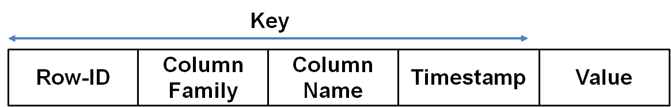
Keys Include Family and Timestamps
Bigtable systems have keys that include not just row and column ID but other attributes
Column Families are created when a table is created
Timestamps allows multiple versions of values
Values are ordered bytes and have no strongly typed data system

Slide 86
Column Store Concepts
Preserve the table-structure familiar to RDBMS systems
Not optimized for "joins"
One row could have millions of columns but the data can be very "sparse"
Ideal for high-variability data sets
Column families allow you to query all columns that have a specific property or properties
Allow new columns to be inserted without doing an "alter table"
Trigger new columns on inserts
Col1
Col100000
…

Slide 87

Cassendra
Apache open source project
Originally developed by Facebook
Used as a key-value store and a bigtable store
Now used by Twitter and many others
Written in Java
Similar to Bigtable and DynamoDB
Designed for highly distributed systems
Column-family data model

Slide 88

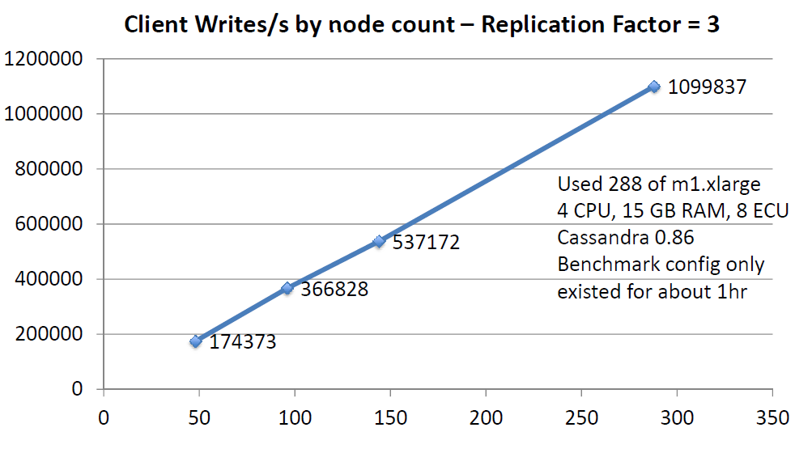
Netflix

Slide 89


Hadoop/Hbase
Open source implementation of MapReduce algorithm written in Java
Initially created by Yahoo
300 person-years development
Column-oriented data store
Java interface
HBase designed specifically to work with Hadoop
High-level query language (Pig)
Strong support by many vendors

Slide 90


Apache Accumulo
Apache open source column-family store
Distributed key-value based on BigTable
Focus on scalability, availability and security
Strong support for in-database fine-grained security
Support by sqrrl.com

Slide 91
Graph Store
Data is stored in a series of nodes, relationships and properties
Queries are really graph traversals
Ideal when relationships between data is key:
e.g. social networks
Pros: fast network search, works with public linked data sets
Cons: Poor scalability when graphs don't fit into RAM, specialized query languages (RDF uses SPARQL)
Examples:
Neo4j, AllegroGraph, Bigdata triple store, InfiniteGraph, StarDog

Slide 92
Graph Stores (Continued)
Used when the relationship and relationships types between items are critical
Used for
Social networking queries: "friends of my friends"
Inference and rules engines
Pattern recognition
Used for working with open-linked data
Automate "joins" of public data

Slide 93
Two Major Graph Models
RDF
Uniform triple stores
W3C Standards
Resource Description Format (RDF)
Standardized query language (SPARQL)
Property Graphs
Nodes and arcs have key-value properties
No standardized query language
Example: Neo4J - Cypher

Slide 94
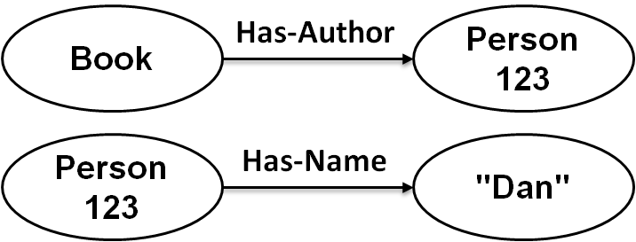
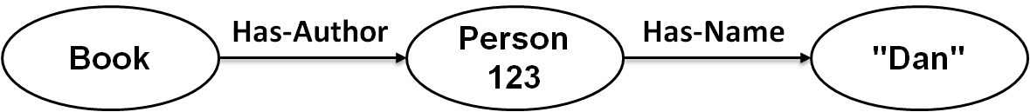
Nodes are "joined" to create graphs
How do you know that two items reference the same object?
Node identification – URI or similar structure

Slide 95
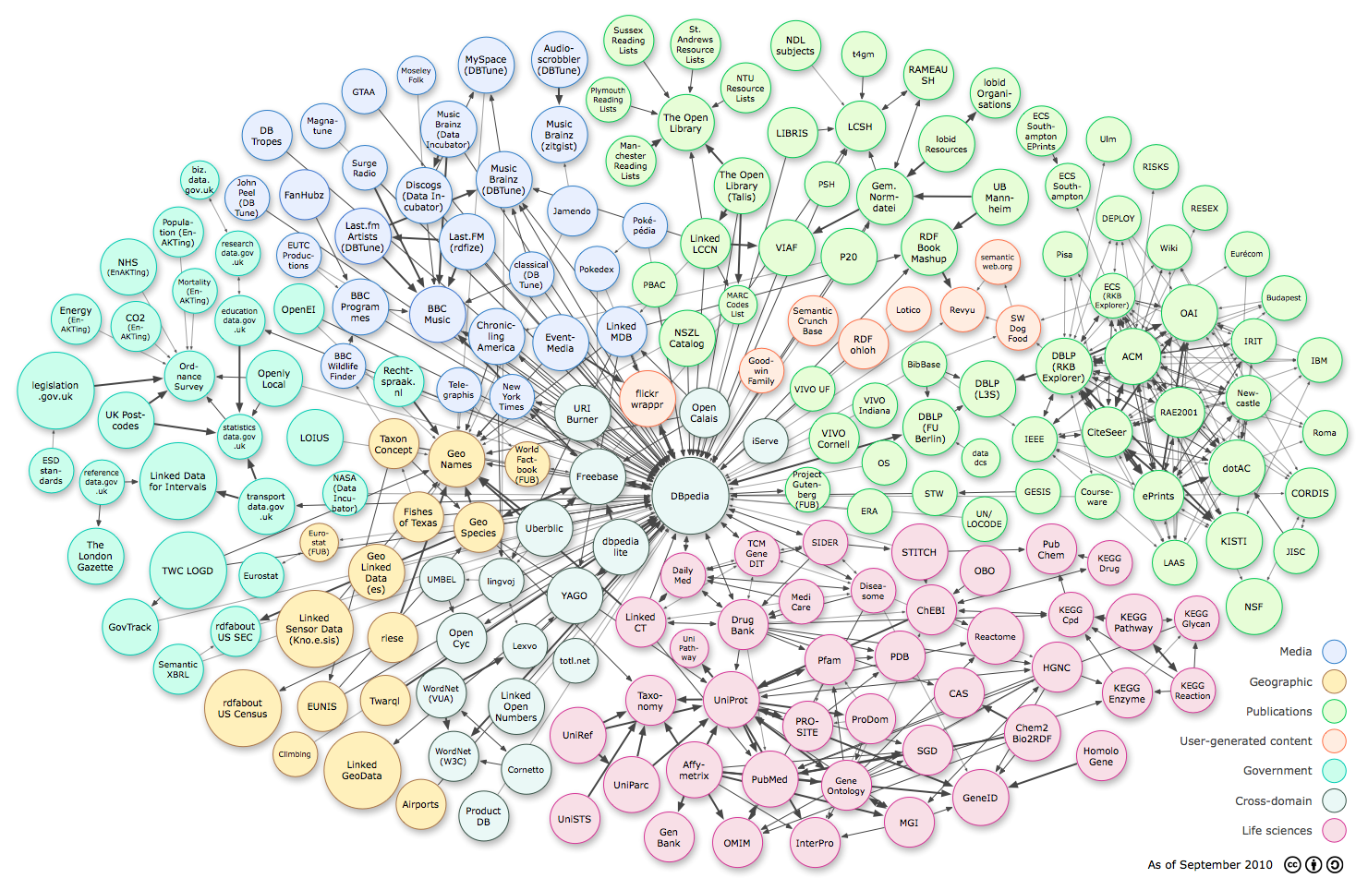
Open Linked Data

Slide 96

Neo4J
Graph database designed to be easy to use by Java developers
Dual license (community edition is GPL)
Works as an embedded Java library in your application
Disk-based (not just RAM)
Full ACID
See http://neo4j.org
Copyright Kelly-McCreary & Associates, LLC

Slide 97

InfiniteGraph
Commercial graph database
Graph property model
Extensive use in intelligence and federal systems
Extensive graph analysis tools
Modular "plug in" security architecture
Used for persisting and traversing complex relationships requiring multiple hops across large distributed graph stores

Slide 98
Document Store
Data stored in nested hierarchies
Logical data remains stored together as a unit
Any item in the document can be queried
Pros: No object-relational mapping layer, ideal for search
Cons: Complex to implement, incompatible with SQL
Examples:
MarkLogic, MongoDB, Couchbase, CouchDB, RavenDB, eXist-db

Slide 99
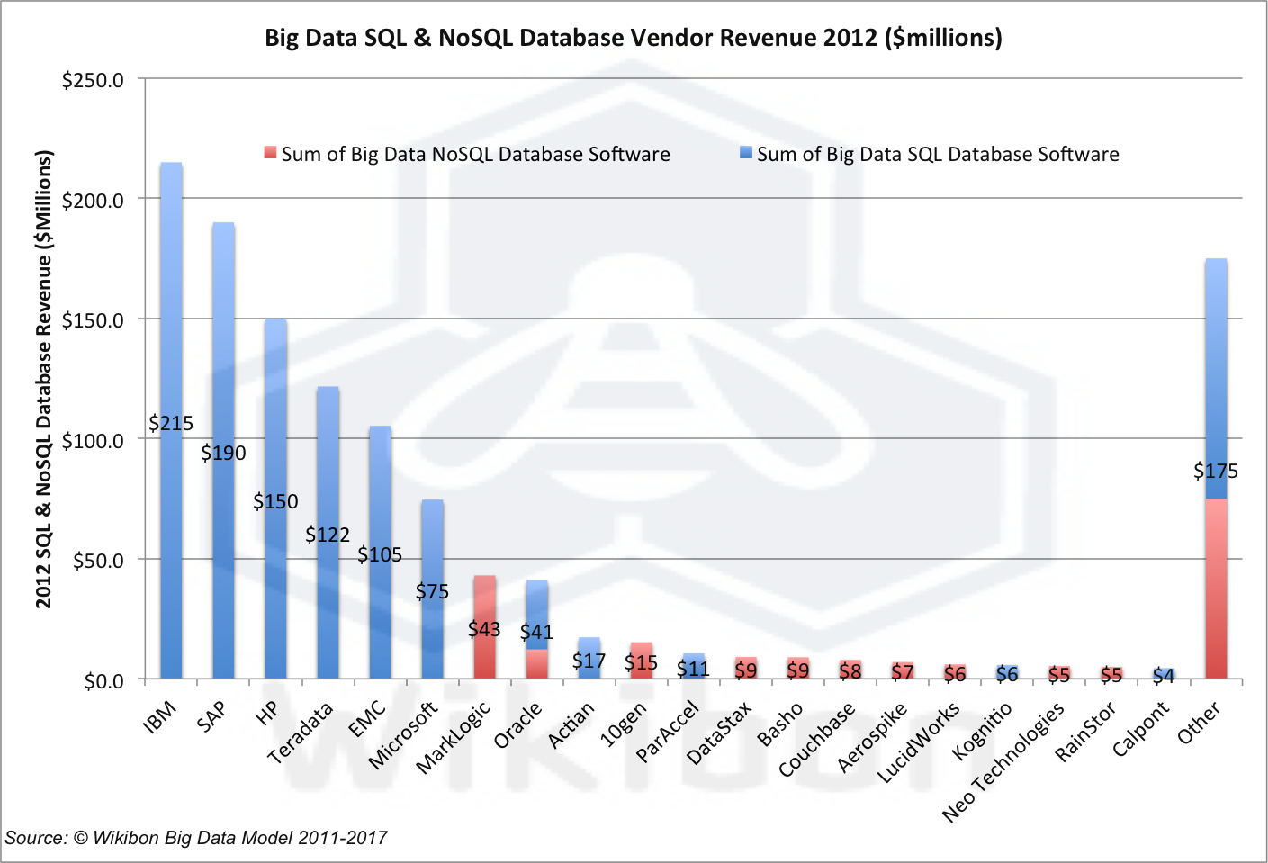
Estimated Big Data and NoSQL Sales
Document Stores

Slide 100
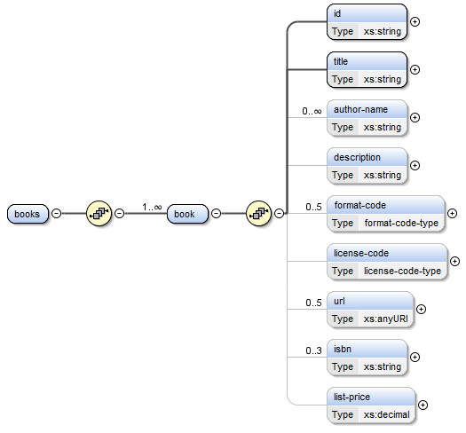
Document Structure
Id and title are required
Darker lines mean "required" and light lines mean optional elements
Books have 0 to many author-names
<books> is our root element
Format and license elements are codes that must be in a fixed list of choices
<books> contain a sequence of one to many <book> elements
Only valid URL characters
Each <book> contains the following sequence of elements
Must be a valid decimal number

Slide 101

Object Relational Mapping
T1
T2
T4
T3
Web Browser
Object Middle
Tier
Relational
Database
T1 – HTML into Objects
T2 –Objects into SQL Tables
T3 – Tables into Objects
T4 – Objects into HTML

Slide 102
"The Vietnam of Applications"
Object-relational mapping has become one of the most complex components of building applications today
A "Quagmire" where many projects get lost
Many "heroic efforts" have been made to solve the problem
Java Hibernate Framework
Ruby on Rails
But sometimes the best way to avoid complexity is to keep your architecture very simple

Slide 103
Document Stores Need No Translation
Document
Document
Application Layer
Database
Documents in the database
Documents in the application
No object middle tier
No "shredding"
No reassembly
Simple!

Slide 104

The Addition of XML Web Services
Web Service
T5
T6
T1
T2
T4
T3
Web Browser
Object Middle
Tier
Relational
Database
T1 – HTML into Java Objects
T2 – Java Objects into SQL Tables
T3 – Tables into Objects
T4 – Objects into HTML
T5 – Objects to XML
T6 – XML to Objects

Slide 105
Zero Translation (XML)
XForms
REST-Interfaces
Web Browser
XML database
XML lives in the web browser (XForms)
REST interfaces
XML in the database (Native XML, XQuery)
XRX Web Application Architecture
No translation!

Slide 106
Structured Search
What happens if you retain document structure when you index your documents?
How can use document structure to increase your precision and relevancy?

Slide 107
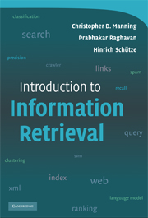
Information Retrieval Textbook
Introduction to Information Retrieval
by Christopher D. Manning, Prabhakar Raghavan and Hinrich Schütze
Cambridge University Press, 2008
http://nlp.stanford.edu/IR-book/information-retrieval-book.html

Slide 108
Table 10.1
 | RDB search | unstructured retrieval | structured retrieval
objects | records | unstructured documents | trees with text at leaves
model | relational model | vector space & others | ?
main data structure | table | inverted index | ?
queries | SQL | free text queries | ?
XML - Table 10.1 and structured information retrieval. SQLRDB (relational database) search, unstructured information retrieval

Slide 109
Table 10.1 - Revised
 | RDB search | unstructured retrieval | structured retrieval
objects | records | unstructured documents | trees with text at leaves
model | relational model | vector space & others | XML hierarchy
main data structure | table | inverted index | trees with node-ids for document ids
queries | SQL | free text queries | XQuery fulltext
XML - Table 10.1 and structured information retrieval. SQLRDB (relational database) search, unstructured information retrieval

Slide 110
Two Models
"Bag of Words"
"Retained Structure"
doc-id
keywords
keywords
'love'
keywords
keywords
'hate'
keywords
'new'
'fear'
keywords
All keywords in a single container
Only count frequencies are stored with each word
Keywords associated with each sub-document component

Slide 111
Keywords and Node IDs
document-id
Node-id
keywords
Node-id
keywords
Node-id
keywords
Node-id
keywords
Node-id
keywords
Node-id
keywords
Keywords in the reverse index are now associated with the node-id in every document

Slide 112
MongoDB
Originally created by 10gen
Originally New York, now CA
Open Source License (AGPL)
Document/collection centric
Sharding built-in, automatic
Stores data in binary JSON format BSON
Native Query language is JSON-like
Implemented in C++ with many APIs (C++, JavaScript, Java, Perl, Python etc.)

Slide 113
Why is Mongo so popular?
Agility!
Document stores eliminate Object/Relation mapping
No more Hibernate/RAILs complexity
Developers love JSON
fewer complexities of XML
familiar to JavaScript developers
Open source license
Excellent developer relationships

Slide 114
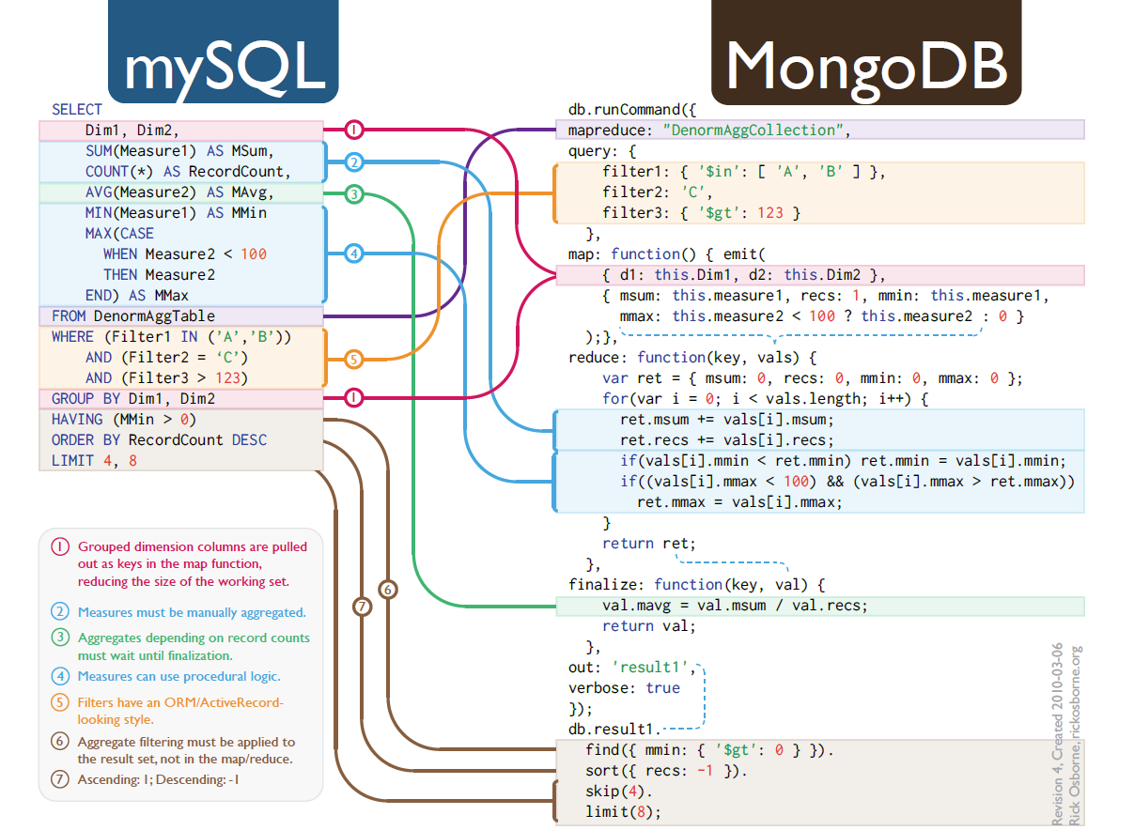
Mongo MapReduce

Slide 115
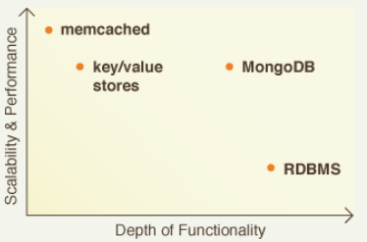
Mongo vs. key/value stores
More functionality than simple key value stores
Functionally similar to a RDBMS
Many features for big-data systems

Slide 116
Couchbase
Open source document store supported by Couchbase, Inc.
Code base no longer directly related to CouchDB!
Code base built on memcached
Written in ERLANG/C++
RESTful JSON API
Distributed, featuring robust, incremental replication with bi-directional conflict detection and management
Strong integration with ElasticSearch for document search

Slide 117
CouchDB
Apache open source document store (JSON)
Strong focus on building web applications (REST, JavaScript on server)
Strong support for high-availability, replication and scalability
Written in Erlang
Support for mobile versions
Strong developer community

Slide 118

MarkLogic
Native XML database designed to scale to Petabyte data stores
Leverages commodity hardware
ACID compliant, schema-free document store
Heavy use by federal agencies, document publishers and "high-variability" data
Arguably the most successful NoSQL company

Slide 119
eXist
Open source native (LGPL) XML database with strong support in Europe
Strong support for XQuery and XQuery extensions
Heavily used by the Text Encoding Initiative (TEI) community and XRX/XForms communities
Integrated Lucene search
Collection triggers and versioning
Extensive XQuery libraries (EXPath)
Version 2.0 also has replication

Slide 120
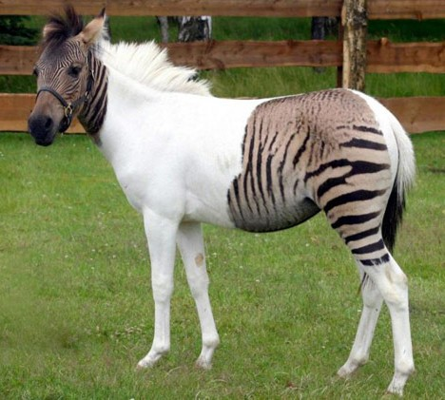
Hybrid architectures
Most real-world implementations use multiple NoSQL solutions together in an application
Example:
Use document stores for data
Use key-value store for distributed cache
Use S3 for image/pdf/binary storage
Use Apache Lucene for document index stores
Use MapReduce for real-time index and aggregate creation and maintenance
Use OLAP for reporting sums and totals
Image: scienceblogs

Slide 121
Other Terms
Merkle Trees – a binary hash tree – where a hash function is used for each leaf and branches up to the root of a file system – fast ways to see if complex documents in tree structures have changed
B-Trees, B+ Trees – binary trees that are used to create fast searches of large data sets
Vector Clocks – an algorithm for detecting dependencies between remote computer systems – used to track what systems may have corrupted data
Bloom Filters – hashing tricks to avoid unnecessary disk operations on large data sets
Consistent Hashing – A way of converting strings of data into a unique key that can be used for fast comparisons

Slide 122
Tools to Help You Select A System
ATAM – Architecture Tradeoff and Modeling
CMU developed process to objectively select a system architecture based on business driven use-cases and quality metrics

Slide 123
ATAM Process Flow
Business
Drivers
Quality
Attributes
User
Stories
Analysis
Architecture Plan
Architectural
Approaches
Architectural
Decisions
Tradeoffs
Impacts
Sensitivity
Points
Non-Risks
Distilled info
Risk Themes
Risks

Slide 124
Sample Use Cases/User Stories
Effort to Load New Data
Effort to Query Data
Effort to Transform Data
Effort to Create RESTful Web Services

Slide 125
Insert/Select/Publish Comparison
SQL
SQL
Effort
SQL
logical
data
modeling
Java
Tomcat
AXIS
JDBC
SQL
XQuery
WebDAV
XQuery
Insert
Query
Create
Publishing
Web Service
XQuery
Total Effort

Slide 126
Sample Quality Tree
Fulltext Search
Fulltext search on document data. (H, H)
Searchability
XML Search
Fast searching. (H, H)
Custom Scoring
Scoring via XQuery. (M, H)
XML Importability
Drag-and-drop
Easy to add new XML data. (C, H)
Bulk Import
Batch Import tools. (M, M)
Transformability
XQuery
Easy to transform XML data. (H, H)
XSLT
Transform to HTML or PDF. (VH, H)
Works with web standards. (VH, H)
Project
Affordability
No License Fees
Use OpenSource Software. (H, H)
Standards Based
No complex languages to learn. (H, H)
Staff training. (H, M)
Sustainability
Standards
Use long standing Standards. (VH, H)
Ease of Change
Use declarative languages. (VH, H)
Customizable by non-programmers. (H, H)
Interoperability
Web Services
Use W3C Standards. (VH, H)
No Translation
Mashups wtih REST Interfaces. (VH, H)
Works with W3C Forms. (H, M)
Security
Fine Grain Control
Prevents unauthorized access. (H, H)
Role-based
Collection-based access. (H, M)
Centralized security policy. (H, M)
Key: (Importance, Score)
Important to the Project C=Critical, VH=Very High, H=High, M=Medium
Architectural Score H=High, M=Medium, L=Low

Slide 127
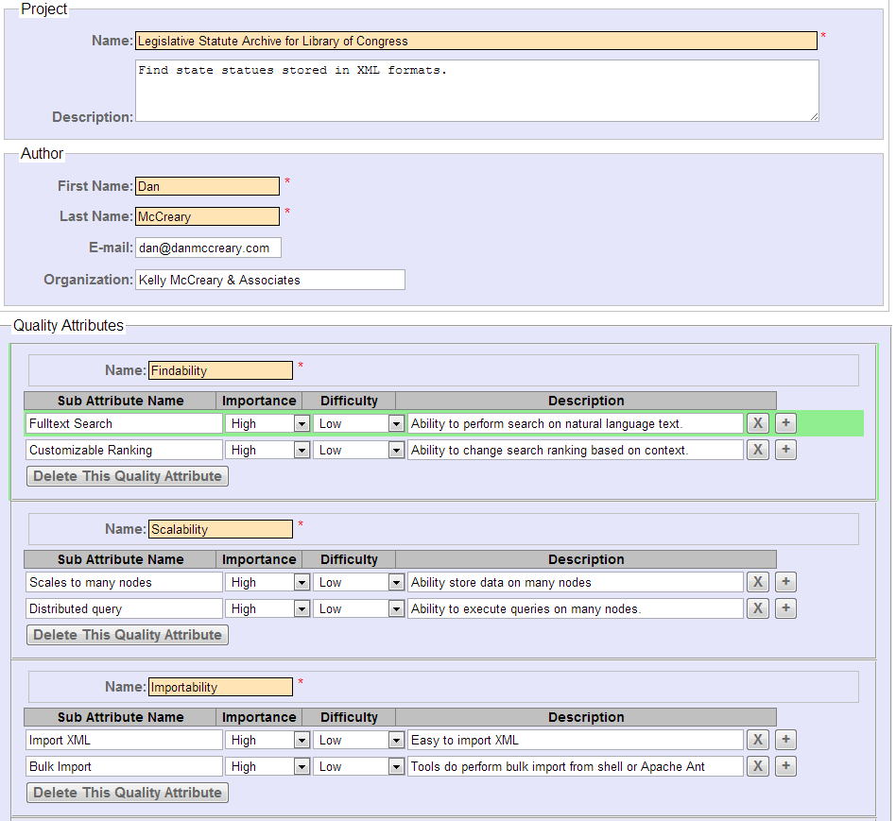
Quality Attribute Tree App

Slide 128
The Hard Part
Assigning organizational "value" to
Ease of use
Standards
Vendor viability
Open source project viability
Portability
Example:
WebDAV support

Slide 129
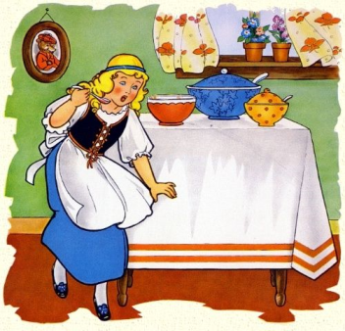
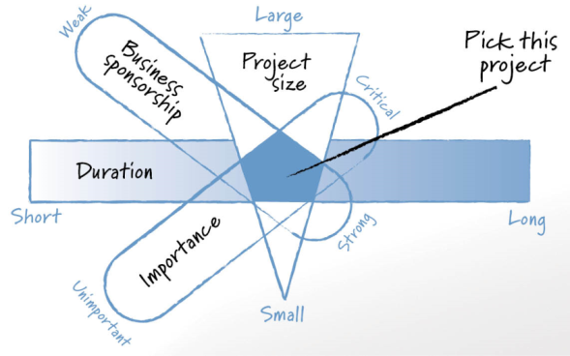
Selecting a NoSQL Pilot Project
The "Goldilocks Pilot Project Strategy"
Not to big, not to small, just the right size
Duration
Sponsorship
Importance
Skills
Mentorship

Slide 130


Using the Wrong Architecture
Start
Finish
Credit: Isaac Homelund – MN Office of the Revisor

Slide 131

Using the Right Architecture
Start
Finish
Find ways to remove barriers and empower
the non programmers on your team.

Slide 132

If You Give a Kid a Hammer…
…the whole world becomes a nail
People solve problems using familiar tools
People develop specific Cognitive Styles* based on training and experience
What are we teaching the next generation of developers?
* Source: Shoshana Zuboff: In the Age of the Smart Machine (1988)
Notes:
Zuboff studied paper mills. She looked at how technology had an impact on how people solved problems.
Her work indicated that individuals that can quickly learn to manipulate abstractions will attain more power and influence in organizations.

Slide 133
The Challenge of Bias in DB Selection
Anchoring bias - the tendency to produce an estimate near a cue amount - "Our managers were expecting an RDBMS solution so that’s what we gave them." Availability heuristic - the tendency to estimate that what is easily remembered is more likely than that which is not. - "I hear that NoSQL does not support ACID." or "I hear that XML is verbose?" Bandwagon effect - the tendency to do or believe what others do or believe - "Everyone else at this company and in our local area uses RDBMSs." Confirmation bias - the tendency to seek out only that information that supports one's preconceptions – "We only read posts from the Oracle|Microsoft|IBM groups." Framing effect - the tendency to react to how information is framed, beyond its factual content "We know of some NoSQL projects that failed." Gambler's fallacy (aka sunk cost bias) the failure to reset one's expectations based on one's current situation – "We already paid for our Oracle|Microsoft|IBM license so why spend more money?" Hindsight bias - the tendency to assess one's previous decisions as more efficacious than they were – "Our last five systems worked on RDBMS solutions". Halo effect - the tendency to attribute unverified capabilities in a person based on an observed capability. – "Oracle|Microsoft|IBM sells billions of dollars of licenses each year, how could so many people be wrong". Representativeness heuristic - the tendency to judge something as belonging to a class based on a few salient characteristics - "Our accounting systems work on RDBMS so why not our product search?"

Slide 134
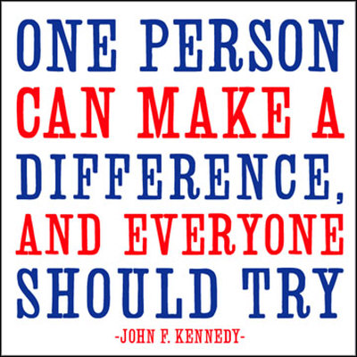
Can One Person Make a Difference?
What if you work for a big company?
…and they have spent millions of dollars on software licenses for RDBMS systems
…and they have 100s of employees that have been trained in SQL
…and they have dozens of existing applications running on their current system
…and some people are happy with their current system
…what should I do?

Slide 135


The Future of the NoSQL Movement
Growth
Diversity
Will data sets continue to grow at exponential rates?
Will new system options become more diverse?
Will new markets have different demands?
Will some ideas be "absorbed" into existing RDBMS vendors products?
Will the NoSQL community continue to be the place where new database ideas and products are incubated?
Will there be standards in NoSQL?
Will the job of doing high-quality architectural tradeoffs analysis become easier?

Slide 136
Making Sense of NoSQL
http://manning.com/mccreary

Slide 137
Questions
Thank You!
Dan McCreary
dan@danmccreary.com

